Slide 1
The Market System and the Circular Flow
From:
Book 1: Chapter 2

Slide 2
Economic Systems
Laissez-Faire Capitalism
The term “laissez-faire” is the French for “let it be,”
In laissez-faire capitalism —or “pure capitalism”—the government’s role would be limited to protecting private property from theft and aggression and establishing a legal environment in which contracts would be enforced and people could interact in markets to buy and sell goods, services, and resources.

Slide 3
Economic Systems (Cont’d)
The Command System
The polar opposite of laissez-faire capitalism
government owns most property resources
economic decision making is set by a central planning board created and enforced by the government.
also known as socialism or communism .

Slide 4
Economic Systems (Cont’d)
The Market System
also known as capitalism or the mixed economy.
no single individual or organization or government is responsible for solving the economic problems in a market economy.
characterized by a mixture of centralized initiatives and decentralized actions
The precise mixture varies from country to country
Not Chaos, but Economic Order

Slide 5
Characteristics of the Market System
1. Private Property
private individuals and firms, not the government, own most of the property resources (land and capital).
Consequences of property rights:
mutually agreeable economic transactions take place
encourage investment, innovation, exchange, maintenance of property, and economic growth
facilitate exchange
encourage owners to maintain or improve their property so as to preserve or increase its value.
extend to intellectual property through patents, copyrights, and trademarks.

Slide 6
Characteristics of the Market System
2. Freedom of Enterprise and Choice
Freedom of enterprise ensures that entrepreneurs and private businesses are free to obtain and use economic resources to produce their choice of goods and services and to sell them in their chosen markets.
Freedom of choice enables
owners to employ or dispose of their property and money as they see fit.
workers to try to enter any line of work for which they are qualified.
consumers are free to buy the goods and services that best satisfy their wants and that their budgets allow.

Slide 7
Characteristics of the Market System
3. Self-Interest
motivating force of the various economic units as they express their free choices.
Self-interest simply means that each economic unit tries to achieve its own particular goal, which usually requires delivering something of value to others.
Entrepreneur, Property owner, Worker, Consumer

Slide 8
Characteristics of the Market System
4. Competition
competition requires:
Two or more buyers and two or more sellers acting independently in a particular product or resource market.
Freedom of sellers and buyers to enter or leave markets, on the basis of their economic self-interest.
no single will dictate the price – limit the potential abuse of power
It is the basic regulatory force in the market system.

Slide 9
Characteristics of the Market System
5. Markets and Prices
market is an institution or mechanism that brings buyers (“demanders”) and sellers (“suppliers”) into contact.
A market system conveys the decisions made by buyers and sellers of products and resources.
Just as competition is the regulatory mechanism of the market system, the market system itself is the organizing and coordinating mechanism.

Slide 10
Characteristics of the Market System
6. Technology and Capital Goods
competition, freedom of choice, self-interest, and personal reward provide the opportunity and motivation for technological advance.
The monetary rewards for new products or production techniques accrue directly to the innovator.
Advanced technology and capital goods are important for efficiency.
More efficient production means much more abundant output.

Slide 11
Characteristics of the Market System
7. Specialization
using the resources of an individual, firm, region, or nation to produce one or a few goods or services rather than the entire range of goods and services.
Those goods and services are then exchanged for a full range of desired products.
Society learned long ago that self-sufficiency breeds inefficiency.
Human Specialization: “Division of Labor”
Geographic Specialization

Slide 12
Characteristics of the Market System
8. Use of Money
Money performs several functions, but first and foremost it is a medium of exchange. It makes trade easier.
Exchange can, and sometimes does, occur through barter but it requires a coincidence of wants
To serve as money, an item needs to pass only one test: It must be generally acceptable to sellers in exchange for their goods and services.
Money is socially defined; whatever society accepts as a medium of exchange is money.

Slide 13
Characteristics of the Market System
9. Active, but Limited, Government
An active, but limited, government is the final characteristic of market systems in modern advanced industrial economies.

Slide 14
Five Fundamental Questions
The key features of the market system help explain how market economies respond to five fundamental questions:
What goods and services will be produced?
How will the goods and services be produced?
Who will get the goods and services?
How will the system accommodate change?
How will the system promote progress?

Slide 15
What goods and services will be produced?
The answer: It is determined by the dollar votes of consumers in their daily purchase decisions.
Horses and horseshoes VS automobile and tires.
Consumers register their preferences in the market; producers and resource suppliers, prompted by their own self-interest, respond appropriately.

Slide 16
How will the goods and services be produced?
The answer: In combinations and ways that minimize the cost per unit of output.
Because inefficiency drives up costs and lowers profits.
Firm make efforts to minimize production costs.
These efforts intensified due to competition
Simply stated: Competition eliminates high-cost producers.

Slide 17
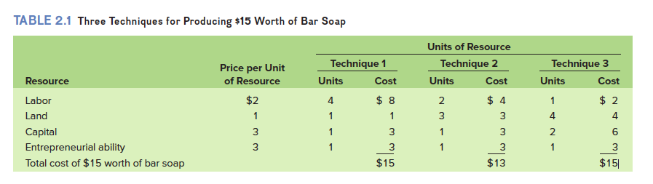
Example (pg. 34)

Slide 18
Who will get the goods and services?
Consumers on the basis of their ability and willingness to pay its existing market price.
The ability depends on the amount of income
The amount of income depends on:
the quantities of the property and human resources they supply and
the prices those resources command in the resource market.
Resource prices (wages, interest, rent, profit) are crucial in determining the size of each person’s income and therefore each person’s ability to buy part of the economy’s output.

Slide 19
How will the system accommodate change?
Through directing or guiding function of prices and profits
Market systems are dynamic:
Consumer preferences, technologies, and resource supplies all change.
The market system is a gigantic communications system.
Through changes in prices and profits, it communicates changes
Consumer tastes direct the expansion of some industries and the contraction of others.
Those adjustments are conveyed to the resource market.

Slide 20
How will the system promote progress?
Society desires economic growth (greater output) and higher standards of living (greater output per person)
technological improvements and capital accumulation, contribute to a higher standard of living for society
Technological Advance
The market system provides a strong incentive for it through Creative Destruction
Capital Accumulation
Most technological advances require additional capital goods.

Slide 21
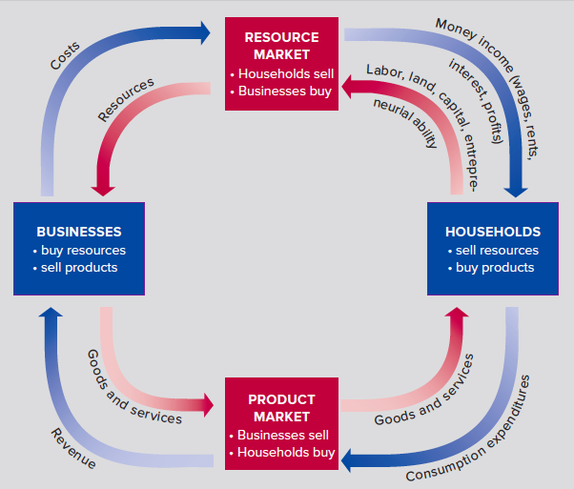
The Circular Flow Model (Fig. 2.2)

Slide 22
The Circular Flow Model
The model illustrates how resources flow from households to businesses and how payments for those resources flow from businesses to households.
Figure 2.2 represents:
Households
Businesses
Sole proprietorship
Partnership
Corporation
Product Market
Resource Market

Slide 23
